Slide 1
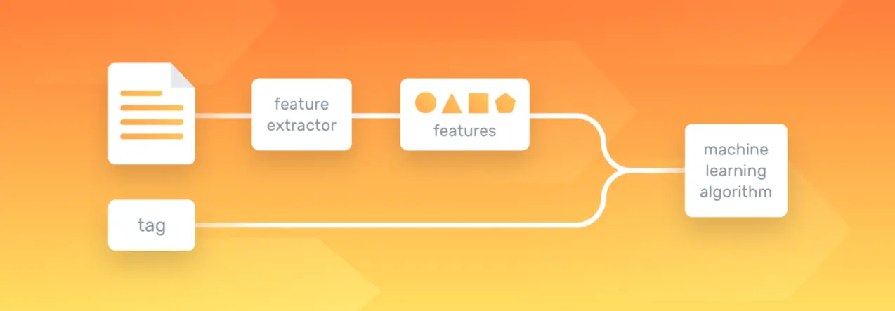
Machine Learning’s Natural Language Processing with a few sample applications
Anton Georgescu
Principal Product Architect, TEMS
Standish, Ontario

Slide 2
Table of Content
What is Natural Language Processing (NLP)
Benefits of Natural Language Processing
How does Natural Language Processing work?
Natural Language Processing levels
Syntactic Analysis techniques & tasks
Semantic Analysis techniques & tasks
Natural Language Processing methods
Rule-based approach
Machine learning models
Natural Language Processing algorithms
Text Classification Algorithms
Text Extraction Algorithms
Topic Modeling Algorithms
Concrete applications of NLP
Natural Language Generation
Named Entity Recognition (NER)
Chatbots

Slide 3
What is Natural Language Processing (NLP)
Natural Language Processing (NLP) is a subfield of artificial intelligence that helps computers understand human language.
combines the power of linguistics and computer science to study the rules and structure of language
create intelligent systems capable of understanding, analyzing, and extracting meaning from text and speech
core of many popular applications:
translation software
chatbots
spam filters (Gmail, Yahoo email)
search engines (Google, Bing)
speech engines (Siri, Alexa, Google, Cortana)
grammar checking software
voice assistants
social media monitoring tools.

Slide 4
Benefits of NLP
Prepares text and speech for machines
so that they’re able to interpret, process, and organize information
bridges the gap between the way we talk and how computers decipher information
Large-scale analysis
allows the machines to perform language-based tasks such as reading text, identifying what’s important, extracting sentiment, or hearing speech, on a large scale.
Structuring unstructured data
human language is complex, varied, and ambiguous, while machine language relies on logical and highly structured languages and information
by using grammatical rules, algorithms, and statistics, it can interpret natural language and provide an appropriate response or action.

Slide 5
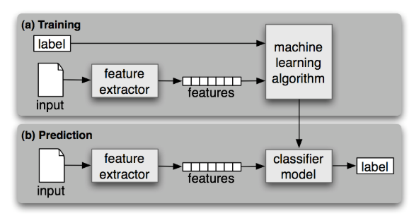
How does NLP work?
It is based on Supervised Classification learning, having *corpora as datasets
During training, a feature extractor is used to convert each input value to a feature set.
Pairs of feature sets and labels are fed into the machine learning algorithm to generate a model.
During prediction, the same feature extractor is used to convert unseen inputs to feature sets.
These feature sets are then fed into the model, which generates predicted labels.
*In linguistics and NLP, corpus (plural corpora) which is Latin for body, refers to a collection of texts.

Slide 6
Natural Language Processing Levels
Syntactic Analysis
also known as parsing or syntax analysis
studies the grammatical rules in natural language with the purpose of uncovering the structure of a text
Semantic Analysis
focuses on identifying the meaning of text
help understand the topic of a text, as it can identify the presence of related concepts
because language is polysemic and ambiguous, semantics is challenging

Slide 7
Syntactic Analysis techniques & tasks
Tokenization
convert the normal text strings into a list of tokens i.e words that we actually want. Sentence tokenizer can be used to find the list of sentences and Word tokenizer can be used to find the list of words in strings.
Stemming
process of reducing inflected (or sometimes derived) words to their stem, base or root form, generally a written word form (e.g. “Stems”, “Stemming”, “Stemmed”, and “Stemtization” are transformed into one word “stem”)
Lemmatization
variant of stemming. The major difference between these is, that, stemming can often create non-existent words, whereas lemmas are actual words. So, your root stem, meaning the word you end up with, is not something you can just look up in a dictionary, but you can look up a lemma
Stopword Removal
remove extremely common words which would appear to be of little value in helping select documents matching a user need are excluded from the vocabulary entirely. These words are called stop words

Slide 8
Semantic Analysis techniques & tasks
Word Sense Disambiguation
Relationship Extraction

Slide 9
Natural Language Processing Methods
two main technical approaches to Natural Language Processing that create different types of systems
one is based on linguistic rules and the other on machine learning methods.
there is also the third one, Hybrid Approach, that combines both rule-based systems and machine learning systems
allows drawing benefit from the advantages of each of the two main approaches, and gain accuracy in your results.

Slide 10
Rule-Based Approach
Word Sense Disambiguation
Relationship Extraction

Slide 11
Machine Learning Models
Word Sense Disambiguation
Relationship Extraction

Slide 12
Natural Language Processing Algorithms
Text Classification Algorithms
Text Extraction Algorithms
Topic Modeling Algorithms

Slide 13
Text Classification Algorithms
Naive Bayes
Support Vector Machines (SVM)
Deep Learning with Deep Neural Networks (DNN)

Slide 14
Text Extraction Algorithms
TF with IDF (term frequency-inverse document frequency)
is a scoring of how rare the word is across documents.
Tf-IDF weight is a weight often used in information retrieval and text mining. This weight is a statistical measure used to evaluate how important a word is to a document in a collection or corpus
TF with Cosine Similarity
TF-IDF is a transformation applied to texts to get two real-valued vectors in vector space. We can then obtain the Cosine similarity of any pair of vectors by taking their dot product and dividing that by the product of their norms. That yields the cosine of the angle between the vectors. Cosine similarity is a measure of similarity between two non-zero vectors
Regular Expressions (regex)
CRF (conditional random fields)
Rapid Automatic Keyword Extraction (RAKE)

Slide 15
Text Extraction Algorithms (cont’d)
Bag of Words
After the initial preprocessing phase, we need to transform the text into a meaningful vector (or array) of numbers. The bag-of-words is a representation of text that describes the occurrence of words within a document. It involves two things:
A vocabulary of known words.
A measure of the presence of known words.
Why is it is called a “bag” of words? That is because any information about the order or structure of words in the document is discarded and the model is only concerned with whether the known words occur in the document, not where they occur in the document.
The intuition behind the Bag of Words is that documents are similar if they have similar content. Also, we can learn something about the meaning of the document from its content alone.
For example, if our dictionary contains the words {Learning, is, the, not, great}, and we want to vectorize the text “Learning is great”, we would have the following vector: (1, 1, 0, 0, 1).

Slide 16
Topic Modeling Algorithms
Latent Semantic Analysis (LSA)
Latent Dirichlet Allocation (LDA)

Slide 17
Concrete applications of NLP
Text classification
Sentiment analysis (hands-on demo)
Topic classification
Intent detection
Text Extraction
Keyword extraction (hands-on demo)
Named Entity Recognition (NER) (hands-on demo)
Topic Modeling
Automatic Summarization
Machine Translation
Natural Language Generation
Chatbots (hands-on demo)

Slide 18
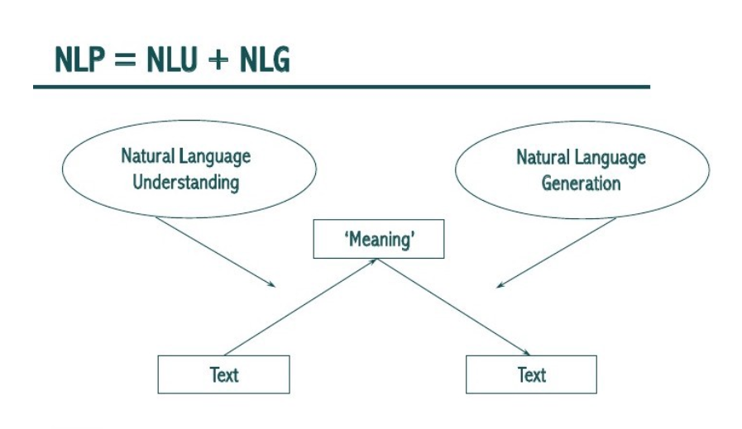
Natural Language Generation
NLP — Natural Language “Processing”
NLU — Natural Language “Understanding”
NLG — Natural Language “Generation”

Slide 19
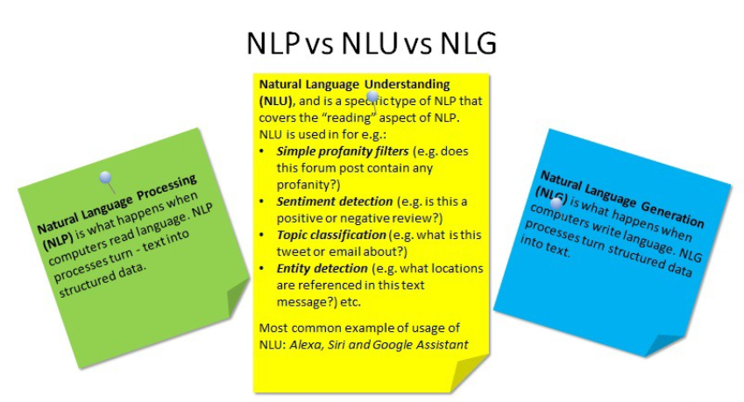
Natural Language Generation (cont’d)
NLU takes up the understanding of the data based on grammar, the context in which it was said and decide on intent and entities.
NLP will convert the text into structured data.
NLG generates text generated based on structured data.

Slide 20
Text Extraction: Named Entity Recognition (NER)
Intents:
Intents are nothing but verbs(activities that the user needs to do). If we want to capture a request, or perform an action, use an intent. In the example play is the intent.
Entities:
Entities are the nouns or the content for the action that needs to be performed. In this case, cricket is a noun.
It is possible to have multiple intents(like checking the weather, checking ground available, checking friends availability) for a single entity playing and also multiple entities for intent and multiple intents for multiple entities.

Slide 21
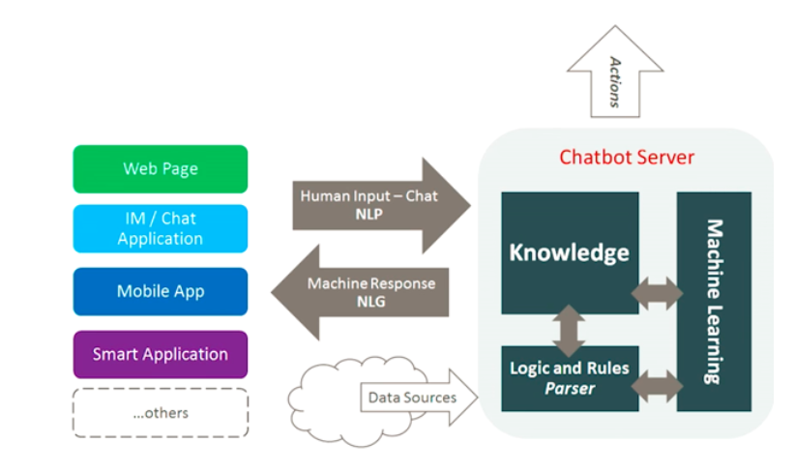
What are chatbots?
A chatbot is a computer program which conducts a conversation via auditory or textual methods.
Chatbots are typically used in dialog systems for various practical purposes including customer service or information acquisition.
Some chatterbots use sophisticated natural language processing systems, but many simpler systems scan for keywords within the input, then pull a reply with the most matching keywords, or the most similar wording pattern, from a database.

Slide 22
How do chatbots work?
There are 2 variants of chatbots
Rule-based approach, a bot answers questions based on some rules on which it is trained on. The rules defined can be very simple to very complex. The bots can handle simple queries but fail to manage complex ones.
Self-learning bots are the ones that use some Machine Learning-based approaches and are definitely more efficient than rule-based bots. These bots can be of further two types:
Retrieval Based - a chatbot uses some heuristic to select a response from a library of predefined responses. Heuristics for selecting a response can be engineered in many ways, from rule-based if-else conditional logic to machine learning classifiers.
Generative - can generate the answers and not always replies with one of the answers from a set of answers. This makes them more intelligent as they take word by word from the query and generates the answers.

Slide 23
NLP with Python: NLTK package
NLTK (Natural Language Toolkit) is a leading platform for building Python programs to work with human language data.
It provides easy-to-use interfaces to over 50 corpora and lexical resources such as WordNet, along with a suite of text processing libraries for classification, tokenization, stemming, tagging, parsing, and semantic reasoning, wrappers for industrial-strength NLP libraries.

